Slide 1
Overview of IBM InfoSphere Information Server
Lesson 5: Administration

Slide 2
Lesson Objectives
On completion of this lesson, you will be able to:
Administer security, entitlements, clusters and high availability configurations, logs, schedules, and services, and back up data.

Slide 3
Administration Overview
Both the IBM InfoSphere Information Server console and the IBM InfoSphere Information Server Web console provide administration capabilities.
As part of InfoSphere Information Server administration, you set up and manage suite security. Security administration includes the following tasks:

Slide 4
Administration Overview
Configuring and administering the user registry
The user registry holds user account information, such as user names and passwords, that can be accessed during authentication. You choose a user registry for the suite to use. You can choose the internal InfoSphere Information Server user registry, or an external local operating system or lightweight directory access protocol (LDAP) user registry. Depending on the registry you choose and the topology of your installation, you might also have to map credentials from one user registry to another.
Controlling access
You create user accounts and groups. You assign roles to users and groups to specify which features users can use and which projects a user can access. User roles can be defined at several levels that build on one another.

Slide 5
Administration Overview Continued
Auditing security-related events
Security-related events include all activities that set or modify security-related settings and all user authentications and application access attempts. You configure which events to log and how much information to include. You monitor and analyze the log information to help prevent unauthorized access to sensitive data.
Administering account passwords
You periodically change administrator account passwords to comply with your security policies.
Managing active user sessions
You view current active sessions, and manage session limits. If necessary, you can force one user or all users to disconnect.

Slide 6
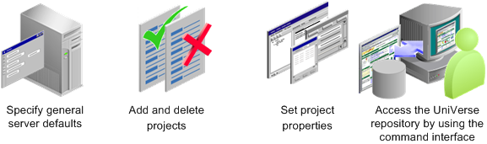
Information Server Product Components
The IBM WebSphere DataStage client enables you to administer projects, edit repository contents, and create, edit, schedule, run, and monitor ETL jobs.
Three components comprise the DataStage client:
DataStage Administrator
DataStage Designer
DataStage Director
DataStage Administrator
The DataStage Administrator enables you to:

Slide 7
Information Server Product Components
DataStage Designer
DataStage Designer enables you to:
Create, edit, and view objects in the metadata repository.
Create, edit, and view data elements, table definitions, transforms, and routines.
Import and export DataStage components, such as projects, jobs, and job components.
Create ETL jobs, job sequences, containers, routines, and job templates.
Create and use parameters within jobs.
Insert and link stages into jobs.
Set stage and job properties.
Load and save table definitions.
Save, compile, and run jobs.

Slide 8
Information Server Product Components
DataStage Director
DataStage Director enables you to:
Validate jobs.
Schedule jobs.
Run jobs.
Monitor jobs.
View log entries and job statistics.

Slide 9
Add/Remove Projects
When you add a new project, you can specify that the new project inherits users and their associated roles from an existing project.
You can also specify that a new project is protected.
This is a special category of project and, normally, nothing can be added, deleted or changed in the project.
Users can view objects in the project, and perform tasks that affect the way a job runs rather than the jobs design; specifically they can:
Run jobs v Set job properties v Set job parameter default values
A newly created protected project is populated by importing developed jobs and components; only a user with the Production Manager role or Administrator role can perform the import, no other types of user can import into a special project.

Slide 10
How to Add/Remove Projects
How to do?
1. Click the Projects tab in the Administrator window to move this page to the front.
2. Click the Add... button. The Add Project dialog box appears.
3. Enter the project name in the Name field. It is automatically appended to the default location for the new project. You cannot add a project to a locatin that already exists.

Slide 11
How to Add/Remove Projects
4. To change the default location, enter a new location in the Location on host field, or use the Browse... button to select a new location.
5. If you want the project to be a protected one, select the Create protected projected check box.
6. If you want to copy the users who can access the new project, and their roles, from an existing project, select Copy roles from existing project, and select the project from which to copy from the list.
7. Click OK.

Slide 12
How to Delete Projects
Ensure that no users are connected to the project you want to delete.
Click the Projects tab on the Administrator window to move this page to the front.
Select the project you want to delete, then click Delete.
You are prompted to confirm the deletion. If you confirm, the project is deleted immediately.
Note:-InfoSphere DataStage returns an error message if you try to delete a project while another user is connected to it

Slide 13
How to Move Projects
To move an InfoSphere DataStage project, you must export it to a file and then import it to the new location.
You then need to delete the original project by using the Administrator client. Before attempting to move a project in this way, ensure that no one is running any jobs in it.
The easiest way to do this is to start the InfoSphere DataStage Director, attaching to the project you want to move, and check whether any jobs are currently running.
When you move projects, project level settings such as environment variable settings and project options are not included.

Slide 14
Setting Project Properties
Click the Projects tab on the Administrator window to move the Projects page to the front.
Select the project.
Click the Properties button.
The Project Properties window appears

Slide 15
Setting Project Properties (Cont..d)
Pages in the Project Properties window to do the following:
General:-Enable job administration from the Director client, enable runtime column propagation for parallel jobs, define a project-wide setting for auto-purge of the job log, set up environment variables, enable the automatic sharing of metadata when importing by using the connector import wizard, and generate operational metadata.
Permissions:- View and assign InfoSphere DataStage user roles to users and groups for a particular project. You assign suite user roles in the IBM InfoSphere Information Server Web console.

Slide 16
Setting Project Properties (Cont..d)
Tracing:- Enable or disable tracing on the InfoSphere Information Server engine.
Schedule:- Set up a user name and password to use for running scheduled InfoSphere DataStage jobs.
The Schedule tab is enabled only if you have logged on to a Windows server.
Mainframe:- Set mainframe job properties and the default platform type. This page is enabled only if mainframe edition is installed.

Slide 17
Setting Project Properties (Cont..d)
Mainframe:- Set mainframe job properties and the default platform type. This page is enabled only if mainframe edition is installed.
Tunables:- Configure cache settings for Hashed File stages.
Parallel:- Set parallel job properties and defaults for date/time and number formats.
Sequence:- Set compilation defaults for job sequences.
Remote. If you have specified that parallel jobs in the project are to be deployed on a USS system, this page allows you to specify deployment mode and USS machine details.

Slide 18
Unit objectives
After completing this unit, you should be able to:
Open the Administrative console
Create new users and groups
Assign Suite roles and Product roles to users and groups
Give users DataStage credentials
Log onto DataStage Administrator
Add a DataStage user on the Permissions tab and specify the user’s role

Slide 19
Information Server Administration Web Console
Web application for administering Information Server
Use for:
Domain management
Session management
Management of users and groups
Logging management
Scheduling management

Slide 20
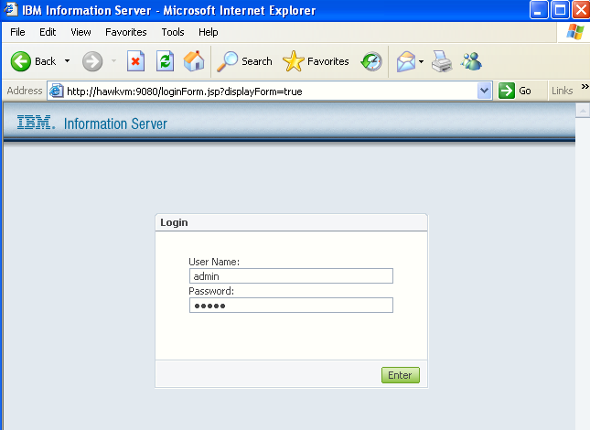
Opening the Administration Web Console
Information Server console address
Information Server administrator ID

Slide 21
Opening the Administration Web Console
To open the Administrative Web Console, select Web Console for IBM Information Server Web Console.
The console address is of the form: http://machine:nnnn.
Here machine is the host name of the machine running the application server that hosts MetaData Server.
nnnn is the port address of the console. By default, it is 9080.
The Information Server administrator ID and password is specified during installation.
After installation, new administrator IDs can be specified.

Slide 22
User and Group Management
Suite authorizations can be provided to users or groups
Users that are members of a group acquire the authorizations of the group
Authorizations are provided in the form of roles
Two types of roles
Suite roles: Apply to the Suite
Suite Component roles: Apply to a specific product or component of Information Server,e.g., DataStage
Suite roles
Administrator
Perform user and group management tasks
Includes all the privileges of the Suite User role
User
Create views of scheduled tasks and logged messages
Create and run reports

Slide 23
User and Group Management (contd…)
Suite Component roles
DataStage
DataStage user
Permissions are assigned within Data Stage
Developer, Operator, Super Operator, Production Manager
DataStage administrator
Full permissions to work in DataStage Administrator, Designer, and Director
And so on, for all products in the Suite

Slide 24
User and Group Management (contd…)
A user ID that is assigned Suite roles can immediately log onto the Information Server console.
What about a user ID that is assigned a DataStage Suite Component role?
If the user ID is assigned the DataStage Administrator role, then the user will immediately acquire the DataStage Administrator permission for all projects.
However, the user will still not necessarily be able to log onto a DataStage client. Why?
Because DataStage credentials are maintained by Windows or LDAP. This means that the user ID must be created and exist on the DataStage Server machine.
If the user ID is assigned the DataStage User role, one more step is required for any DataStage project that user will log onto.
A DataStage Administrator must assign a Developer role to that user ID on the Permissions tab. This is done within DataStage, as we will see later.

Slide 25
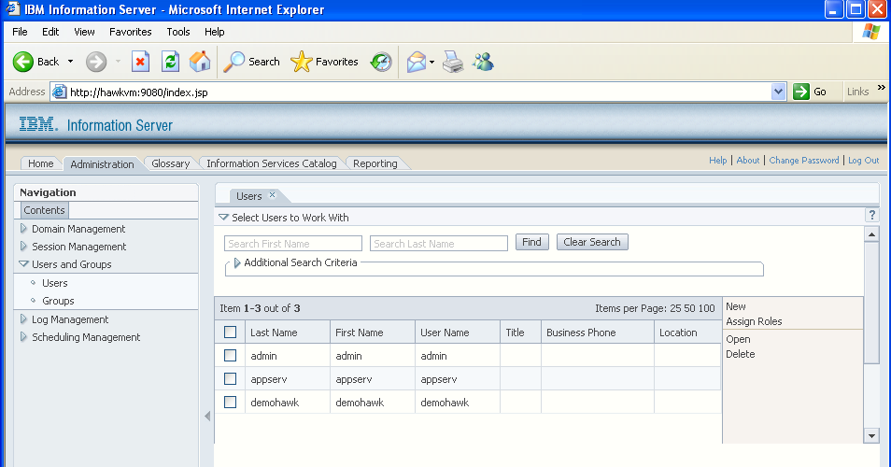
Creating a DataStage User ID
Administration console
Create new user
Users
The process of creating a new group is similar to creating a new user. Users assigned to a group inherit the authorizations assigned to the group.

Slide 26
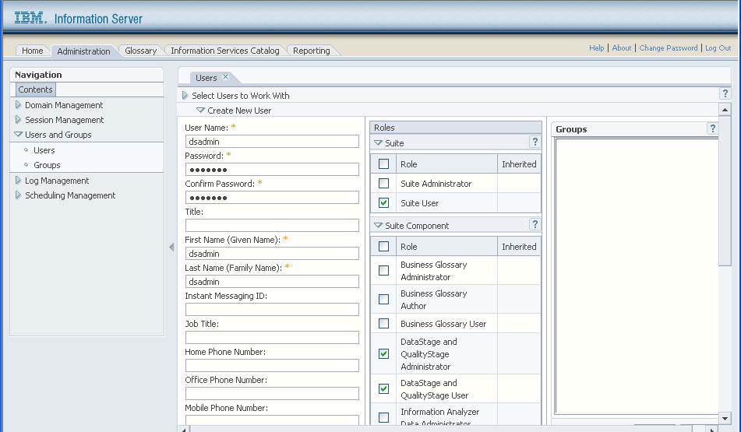
Assigning DataStage Roles
User ID Assign
Assign Suite role
Users
Assign
DataStage User role
Assign DataStage
User role

Slide 27
DataStage Credential Mapping
Users given DataStage Administrator or DataStage User product roles in the Suite Administration console do not automatically receive DataStage credentials
Users with DataStage Administrator roles need to be mapped to a valid user on the DataStage server machine
This DataStage user must have file access permission to the DataStage engine/project files or Administrator rights on the operating system
Users with DataStage User roles need to be mapped to a valid user on the DataStage server machine and need additional DataStage-assigned permissions (developer or operator …)

Slide 28
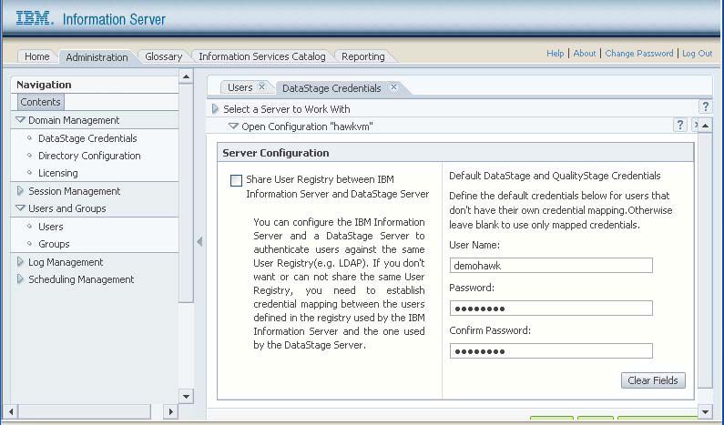
DataStage Credential Mapping
Assign DataStage
User role

Slide 29
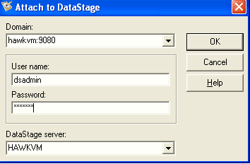
Logging onto Administrator
Host name, port number of application server
DataStage administrator ID and password
Name or IP address of DataStage server machine

Slide 30
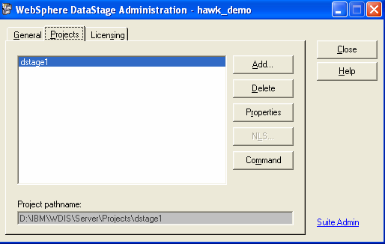
DataStage Administrator Projects Tab
Server projects
Link to Information Server Administration console
Click to specify project properties

Slide 31
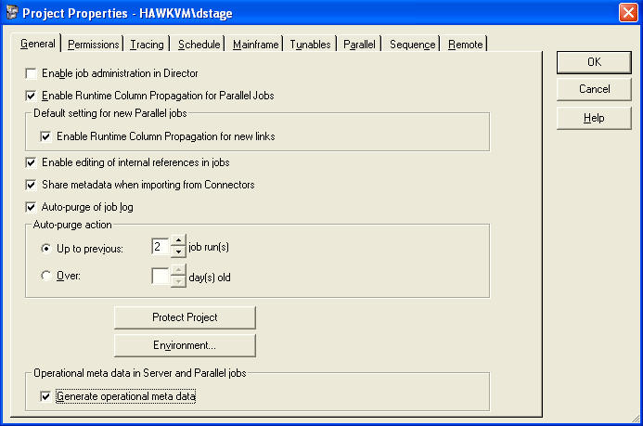
DataStage Administrator General Tab
Enable run time column propagation (RCP) by default
Specify auto purge
Environment variable settings

Slide 32
DataStage Administrator General Tab
Runtime Column Propagation (RCP) is discussed in a later module.
A running job generates many messages in the Director job log. Here you can specify that you want old messages purged.
Click the Environment button to display environment variables settings.

Slide 33
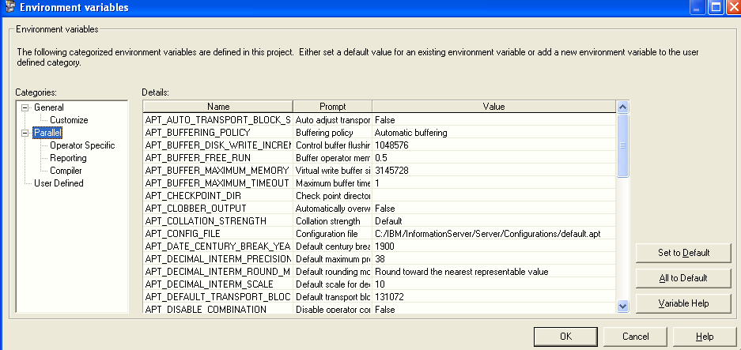
Environment Variables
Parallel job variables
User-defined variables

Slide 34
Environment Variables
Click the Environment button on the General tab to specify environment variables.
The variables listed under the Parallel branch apply to Parallel jobs.
You can also specify your own environment variables under the User Defined branch.
These variables can be passed to jobs through their job parameters to provide project level job defaults.
There are also other environment variables that are hidden from the GUI.

Slide 35
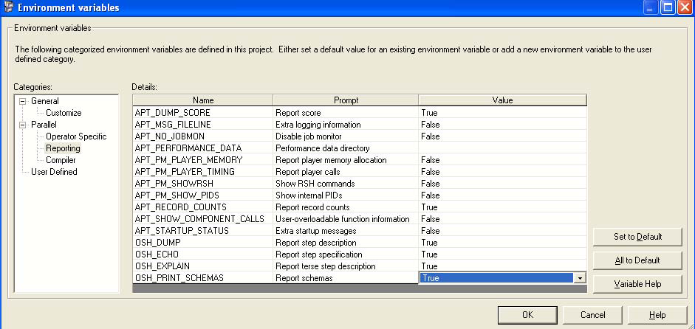
Environment Reporting Variables
Display Score
Display record counts
Display OSH

Slide 36
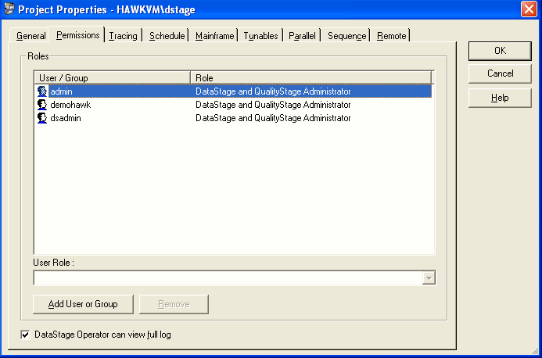
DataStage Administrator Permissions Tab
Assigned product role
Add DataStage users

Slide 37
Permissions Tab
This lists Suite users and groups that have a DataStage User or Administrator role.
When Suite users or groups that have a DataStage Administrator role are added, they are automatically entered here and assigned the role of “DataStage Administrator”.
Suite users or groups that have a DataStage User role need to be manually added.
To accomplish this, click the Add User or Group button (which is hidden in this screen shot).
Then you need to select the DataStage user role (Operator, Super Operator, Developer, Production Manager) that this user ID is to have.

Slide 38
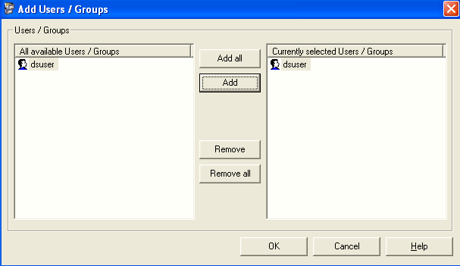
Adding Users and Groups
Available users/groups. Must have a DataStage product User role
Add DataStage users
Click the “Add User or Group” button to open this window. On the left are Information Server users and groups that have been given a DataStage User role.

Slide 39
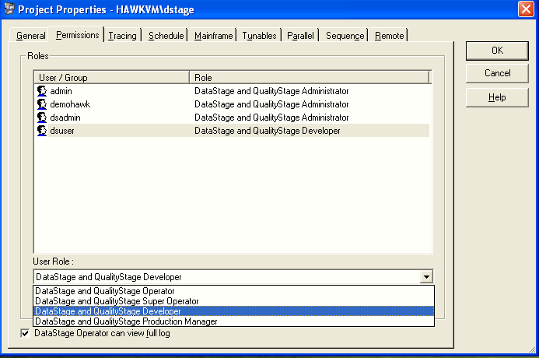
Specify DataStage Role
Added DataStage user
Select DataStage role

Slide 40
Specify DataStage Role
Use this page to set user group permissions for accessing and using DataStage.
All DataStage users must belong to a recognized user role before they can log on to DataStage. This helps to prevent unauthorized access to DataStage projects.
There are four roles that can be assigned to a DataStage user:
DataStage Developer, who has full access to all areas of a DataStage project.
DataStage Operator, who can run and manage released DataStage jobs.
DataStage Super Operator, who can open Designer and view the Repository in a read-only mode.
DataStage Production Manager, who has create and manipulate protected projects.

Slide 41
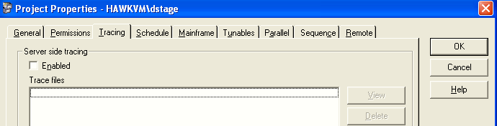
DataStage Administrator Tracing Tab
This tab is used to enable and disable server-side tracing.
The default is for server-side tracing to be disabled.
When you enable it, information about server activity is recorded for any clients that subsequently attach to the project. This information is written to trace files.
Users with in-depth knowledge of the system software can use it to help identify the cause of a client problem.
If tracing is enabled, users receive a warning message whenever they invoke a DataStage client.
Warning: Tracing causes a lot of server system overhead. This should only be used to diagnose serious problems with the help of IBM Data Stage customer support.

Slide 42
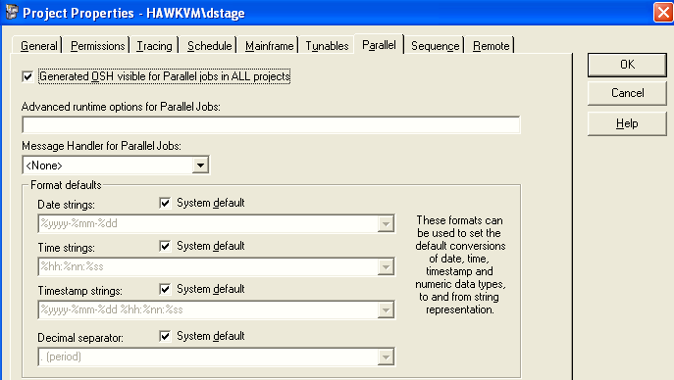
DataStage Administrator Parallel Tab
Use this tab to specify Parallel job defaults.
In addition to displaying the OSH generated by DataStage from Parallel jobs, you specify default formats for dates and times.
In general, you should choose to display the OSH. This provides useful information about how your job works.

Slide 43
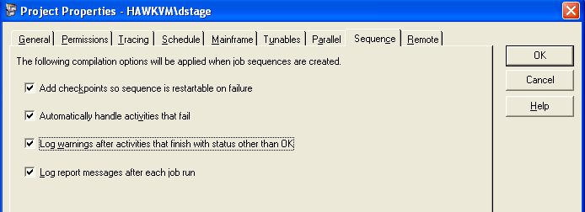
DataStage Administrator Sequence Tab

Slide 44
Importing and Exporting DataStage Objects

Slide 45
What Is Metadata?
Data
Source
Target
Transform
Metadata
Metadata
Metadata
Repository
Notes:
Metadata is “data about data” that describes the formats of sources and targets. This includes general format information such as whether the record columns are delimited and, if so, the delimiting character. It also includes the specific column definitions and their datatypes.

Slide 46
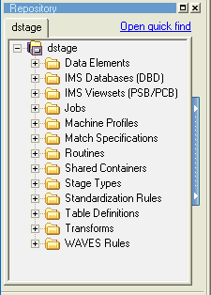
Repository Window
Search for objects in the project
The Repository window displays the folders of objects stored in the repository for the DataStage project logged into.
New folders can be created at any level in which to store repository objects.
Default jobs folder
Project
Default table definitions folder
Notes:
Metadata is “data about data” that describes the formats of sources and targets. This includes general format information such as whether the record columns are delimited and, if so, the delimiting character. It also includes the specific column definitions and their datatypes.

Slide 47
Import and Export
Any object in the repository window can be exported to a file
Can export whole projects
Use for backup
Sometimes used for version control
Can be used to move DataStage objects from one project to another
Use to share DataStage jobs and projects with other developers

Slide 48
Import and Export
Any set of DataStage objects, including whole projects, which are stored in the Repository, can be exported to a file.
This export file can then be imported back into DataStage.
Import and export can be used for many purposes, including:
Backing up jobs and projects.
Maintaining different versions of a job or project.
Moving DataStage objects from one project to another. Just export the objects, move to the other project, then re-import them into the new project.
Sharing jobs and projects between developers. The export files, when zipped, are small and can be easily emailed from one developer to another.

Slide 49
Export Procedure
Click “Export>DataStage Components”
Select DataStage objects for export
Specify type of export:
DSX: Default format
XML: Enables processing of export file by XML applications,
e.g., for generating reports
Specify file path on client machine

Slide 50
Export Procedure
Click Export>DataStage Components to begin the export process.
Any object in Manager can be exported to a file.
Use this procedure to backup your work or to move DataStage objects from one project to another.
Select the types of components to export.
You can select either the whole project or select a portion of the objects in the project.
Specify the name and path of the file to export to. By default, objects are exported to a text file in a special format. By default, the extension is dsx.
Alternatively, you can export the objects to an XML document.
The directory you export to is on the DataStage client, not the server. Objects can also be exported from the list of found objects of a search. This procedure is discussed later in the course.

Slide 51
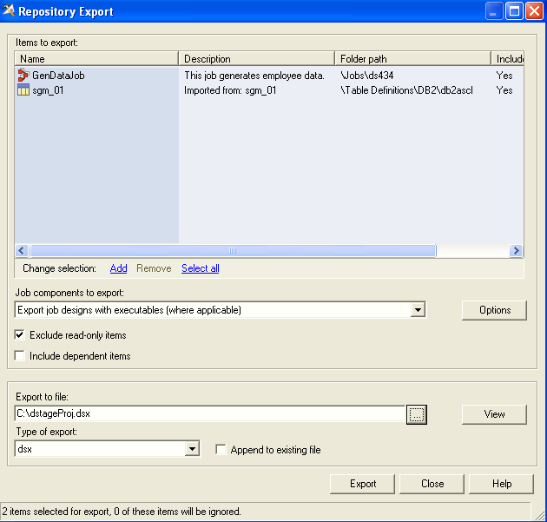
Export Window
Click to select objects from the repository
Selected objects
Default jobs folder
Begin export
Export type

Slide 52
Import Procedure
Click “Import>DataStage Components”
Or “Import>DataStage Components (XML)” if you are importing an XML-format export file
Select DataStage objects for import.
To import DataStage components, click Import>DataStage Components.
Select the file to import.
Click Import all to begin the import process or Import selected to view a list of the objects in the import file.
You can import selected objects from the list.
Select the Overwrite without query button to overwrite objects with the same name without warning.

Slide 53
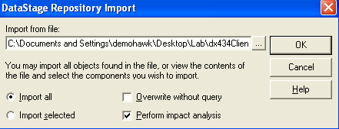
Import Options
Import all objects in the file
Display list to select from
For large imports, you may want to disable “Perform impact analysis.” This adds overhead to the import process.

Slide 54
Q&A
Authorizations can be assigned to what two items?
What two types of authorization roles can be assigned to a user or group?
In addition to Suite authorization to log onto DataStage what else does a DataStage developer require to work in DataStage?

Slide 55
Q&A
Users and groups. Members of a group acquire the authorizations of the group.
Suite roles and Product roles.
Must be mapped to a user with DataStage credentials.

